Slide 1
Sounding Rocket CDR
Team Aether

Slide 2
Presentation Outline
Table of contents | # | Presenter’s name
Intro | (1-4) | Kyle
System Overview | (5-10) | Ryan and Josh
Rocket Design | (11-19) | Zach
Payload Design | (20-22) | Sarah
Mechanical Subsystem | (23-26) | Jake
Payload Electronics | (27-35) | Tyson
Software Design | (36-40) | Adam
Ground System | (41-45) | Hayden
Testing | (46-52) | Emily and Gabe

Slide 3
Team Organization
Names | Roles
Adam | Software Developer
Zach | Rocket Designer
Sarah | Team Captain
Jacob | Mechanical subsystem
Tyson | Payload Electronics
Josh | System Overview
Emily | Testing
Gabriel | Ground Station
Ryan | System Overview
Kyle | Introduction

Slide 4
Acronyms
PDR: Preliminary Design Review
CDR: Critical Design Review
CONOPS: Concept of Operations
CP: Center of Pressure
CG: Center of Gravity
MDRA- Maryland-Delaware Rocketry Association
TWR – Thrust to Weight Ratio
OD- outside diameter
IN- Inside diameter
SH- Spillhole diameter

Slide 5
System Overview

Slide 6
Mission Summary
Mission Summary
Our mission is to launch a sounding rocket, keeping the rocket’s maximum altitude between 1200 and 2000 feet, waiting 5 seconds from launch before taking pictures at a rate of no more than once per second. The rocket must stop taking pictures when it lands.
Include any external objectives
Send pictures from rocket to ground computer.

Slide 7
System Requirement Summary
Payload Requirements, we must have:
A camera with a minimum resolution of 640x480 pixels, in color, no video
An image capture rate of no more than once per second
Images stored in the payload for download after recovery
Telemetry transmitted five times per second, including a timestamp with sufficient resolution, current altitude, speed, acceleration, spin rate, and image number.
A telemetry packet with a packet count that is incremented for each packet

Slide 8
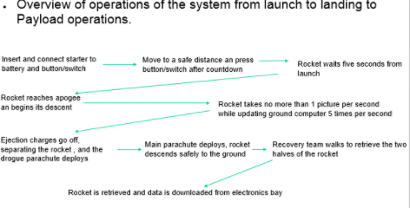
System Concept of Operations

Slide 9
Physical Layout
Diagram of rocket showing major components
The rocket will be 65 inches long, and 3 inch diameter body tube.
The payload will be located in the nose cone, and the main parachute will be located in the front body tube. The drogue chute will be in the back body tube.
Fins
Nose cone
Front body tube
Back body tube
E-Bay

Slide 10
Rocket Design

Slide 11
Changes Since PDR
The ¼ inch plywood fins were replaced by a student designed slip-on ultem 3D printed fin can. The fins still have the same shape, but the mass is less.
We have used 3D printed fin cans like this on high powered rockets for the past 4 years, and are very confident that it will perform correctly.

Slide 12
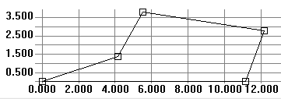
Overview of Rocket
Describe overall rocket design
Designed using Rocksim
Nose cone in the front of the rocket, connected to the front body tube, which is connected to the electronics bay. The back body tube is attached to the electronics bay, and the motor tube is mounted in the back body tube. Finns are mounted on the back body tube.
Rocket weight of 133 ounces
Payload weight of 16 ounces
Cesaroni I216
Airframe diameter of 3”
3 fin design
Rocket length of 65 inches
CP-50.03 inches from nose cone and CG-33.36 inches from nose cone, which is 16.67 inches apart
Fin Dimensions

Slide 13
Rocket Materials
Airframe Material - 1/16 inch Fiberglass Tubing
Fin Material - Ultem
Nosecone material – Fiberglass
Adhesives Used - Rocket-Poxy, 5-Minute Epoxy, and JB Weld. They were all used for centering ring and fin attachment
Rail Guides – Linear Rail Lugs
Active Motor Retention using Aeropack Motor Retainer

Slide 14
Rocket Recovery System
Drogue-24 inch Elliptical parachute
Main- 72 inch Iris Ultra parachute
Descent Rate Under main- 15.4 ft/s
Descent Rate Under drogue- 40.2 ft/s
Harnesses
3/16 inch tubular Kevlar. 15 feet long for front and 15 feet for back half
Swivel to hold parachute using quick links. (880 lbs. max)
Quick links attached to parachutes are attached to the swivel on the shock cord which are secured to eyebolts on the rocket using quick links
Parachutes are protected by Nomex heat shields, and Nomex sleeves are put on the shock cord for protection

Slide 15
Rocket Recovery System Deployment Method
Altimeter used will be a Perfectflite Stratologger CF. Ejection charges will be at apogee and 600 ft above the ground
When loading, an 18 year old student holds electronics bay, while the NAR mentor loads and seals the black powder ejection wells.
To arm the recovery system, while on the pad, key switches are turned arming the altimeter. Key switches are removed and stored with the recovery team.
Key switches are turned arming the recovery system before the igniter is inserted to ensure safety in the case of an accidental launch.
1.9 g of 4F grain size black powder . Through extensive black powder ejection tests, we were able to determine a safe, working amount.

Slide 16
Wiring diagram of altimeter
To Key Switches
To Drogue
To Drogue
To Main
Altimeter
Altimeter
To Main
9V Battery
9V Battery

Slide 17
Rocket Motor Selection
Primary motor selection- Cesaroni I350
Backup motor selection- Cesaroni I540
Primary TWR = 7.42:1
Secondary TWR = 10.6:1 (Added 300g of mass. Motor originally chosen to account for potential payload mass being higher)
Expected Altitude
I-350: 1955 ft
I-540: 1993 ft

Slide 18
Primary Motor Simulations

Slide 19
Secondary Motor Simulations

Slide 20
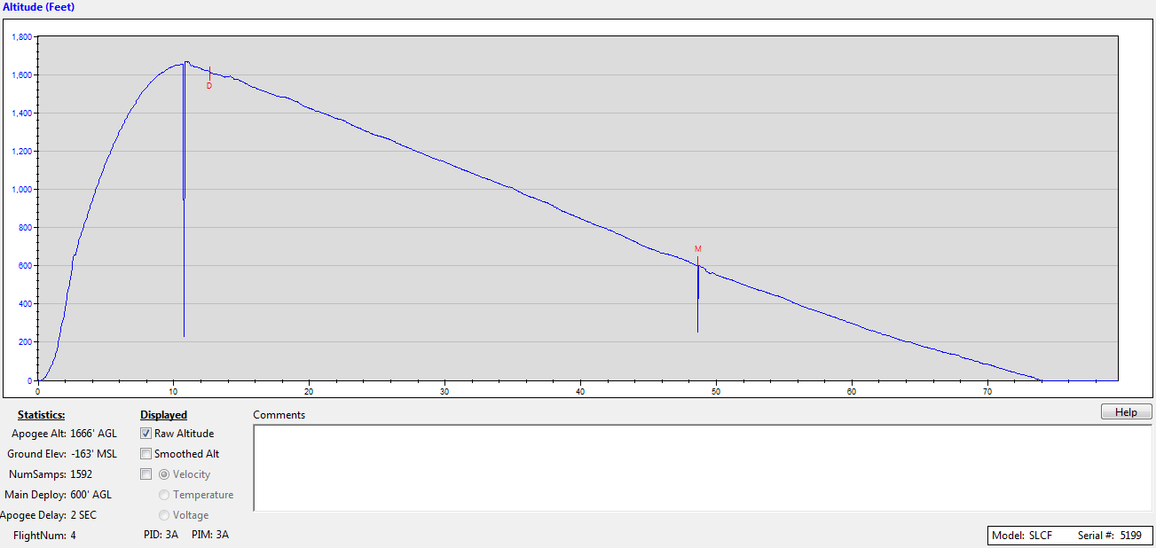
Test Flights
The rocket was flown with a simulated payload mass in it on December 17th successfully.

Slide 21
Payload Design

Slide 22
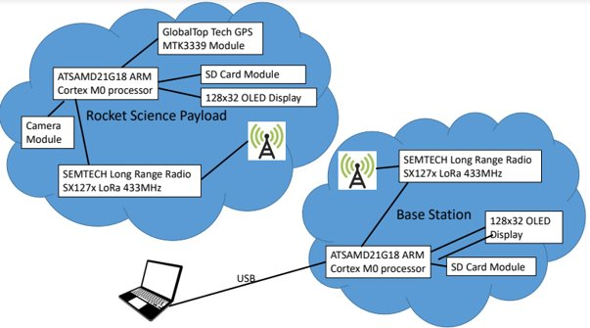
Payload Design Overview
Show block diagram or picture of payload
Identify major components
Dimensions

Slide 23
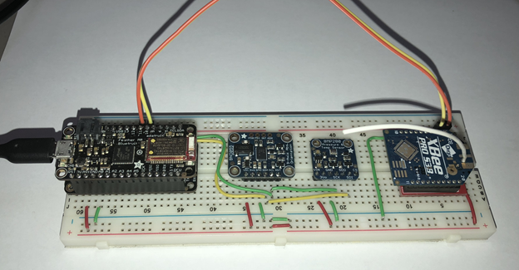
Picture of Payload

Slide 24
Base Station Hardware
Adafruit Feather M0 Adalogger
SparkFun XBee-Pro 900 XSC S3B Wire
SparkFun Breakout Board for XBee Module
Adafruit Half-Size Breadboard
Adafruit Jumper Wire
USB Cable

Slide 25
Rocket Payload components
Adafruit Feather M0 Bluefruit LE
Adafruit Ultimate GPS FeatherWing
Adafruit BME280 I2C or SPI Temperature Humidity Pressure Sensor
Adafruit 9-DOF Absolute Orientation IMU Fusion Breakout - BNO055
SparkFun XBee-Pro 900 XSC S3B Wire
SparkFun Breakout Board for XBee Module
SparkFun Full-Size Breadboard
Adafruit Lithium Ion Cylindrical Battery - 3.7v 2200mAh
Adafruit Mini Spy Camera with Trigger for Photo or Video
SD card for images

Slide 26
Mechanical Subsystem

Slide 27
Mechanical Layout
Mechanical Layout of the payload
All parts will be located in the nose cone.
The camera module will be located with located in the nose cone by cutting a hole and covering the hole with a thin price of plexiglass to prevent damage

Slide 28
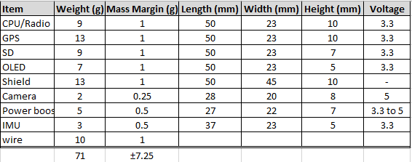
Mechanical Subsystem
Major Mechanical Parts:

Slide 29
Payload Electronics

Slide 30
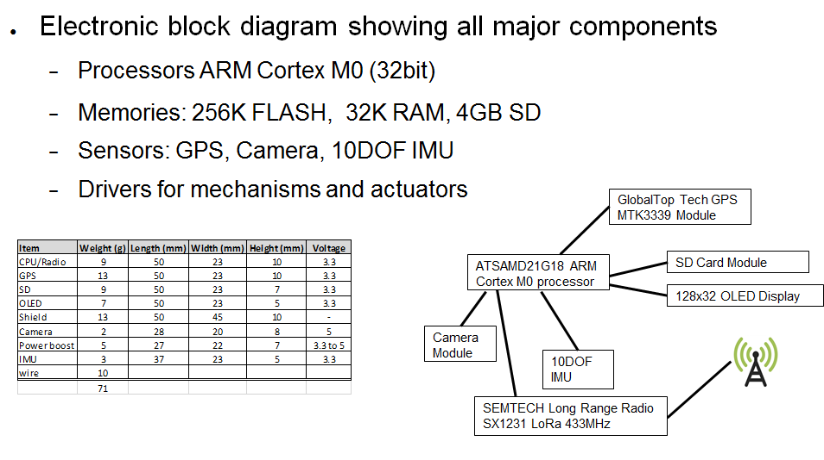
Payload Electronics
Electronic block diagram showing all major components
ARM M0+ Coprocessor
Memories
Sensors
Drivers for mechanisms and actuators

Slide 31
Processor and Memory
ARM Cortex M0
40nm process; 56 Native instructions; 32bit; 256kb storage; 32kb RAM
Up to 66μW/MHz @ 1.8v, 25C
Up to 2.33MHz
Interfaces:
UART for GPS, XBee Radios, and Computer
SPI for BNO055 and BME280
OneWire for Camera
I2C for SD card

Slide 32
Payload Sensors
Camera
640x480 resolution
110mA during operation, 80mA at idle
Connected via OneWire
BNO055
Measures absolute orientation on 3 axis, angular velocity, magnetic field strength, linear acceleration, gravity, and temperature
BME280
Measures temperature, humidity, and barometric pressure

Slide 33
Payload Radio
XBee Radio
XBee ADF7023
902-928 MHz Frequency band
Connected via UART

Slide 34
Payload Radio Antenna
Wire Antenna
Dipole antenna and High-gain antenna
To be mounted in the electronics bay

Slide 35
Payload Power
3.3v Li-ION
Custom battery

Slide 36
Payload Power Distribution
Electrical Power System Design
Adafruit Feather M0

Slide 37
Additional Sensors
GPS
MTK3339 Chipset
Mounting method
20mA current draw
Connected with UART

Slide 38
Software

Slide 39
Payload Software Design
Software Flow Chart
Electronics are armed before the rocket is prepped for launch
The payload is secured into the nosecone’s payload section
At the time the rocket is launched, the payload starts recording data
The payload transmits the data to the ground station live
At landing, the payload stops transmitting data.

Slide 40
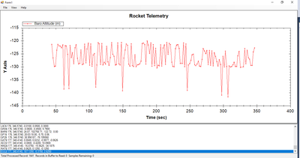
Telemetry
This is a test of using the rocket’s telemetry transmitting software

Slide 41
Software Development Plan
Describe plan for software development
Include
No commercial software is used, but the software is being posted as an open source
The software has been being developed over the last few months, and is still being tweaked, but has been tested and been approved.
The data was successfully transmitted to the ground station, and was able to plot telemetry on a telemetry vs. time graph.

Slide 42
Payload Integration
The payload will be located inside an enclosed tube in the nose cone. There will be a small hole for the camera, which will get larger on the outside in order for the camera to have a wider range of view. It will be mounted in a 3D printed board/case.
There is a bulkhead on both sides of this inner tube, and all-threads connecting them, along with washers and locknuts.

Slide 43
Payload Integration (cont.)
Payload

Slide 44
Ground Station

Slide 45
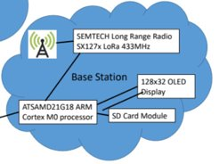
Ground Station Design
Block diagram of ground station

Slide 46
Ground Station Antenna
We are using XBee pro (Digi) antenna
Up to 2000 ft (610 m) Indoor/Urban Range
Up to 9 mi (14 km) LOS w/ Dipole Antenna
Up to 28 mi (45 km) LOS w/ High-Gain Antenna
Up to 24 dBm (250 mW) Tx Power (Software Selectable

Slide 47
Ground Station Software
The ground station software was written by using C# and .Net4.6. The software will be published as an open source under the MIT license.
Open Source Zed Graph software is used to plot the data.
The firmware for both the ground station and rocket payload are written in C++ using the Arduino IDE. The software will also be published as open source under the MIT license.

Slide 48
Ground Station Portability
A cord will connect the receiver to a laptop.
We will have a battery in the laptop and a fully charged backup battery.

Slide 49
Testing

Slide 50
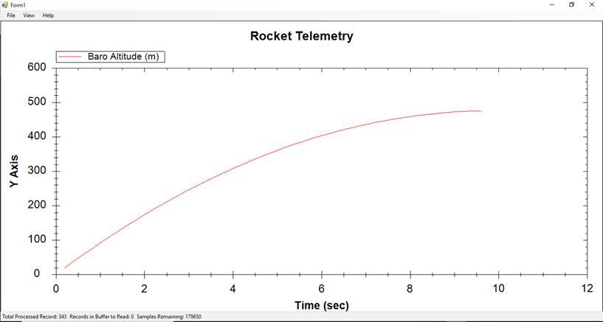
Payload Testing
Two xbee radios have been purchased and tested using simulated data (see plot below)
Testing has shown a total of 27 channels of data sent from the simulated rocket to the base station. The base station system is multi threaded so that data from the radio can be processed at the same time as the plots are updated.
Flight tests with the payload have been delayed by weather, but a test is planned on February 17

Slide 51
Rocket Testing
Rocket was launched successfully on November 18th, 2017
Parachute deployed successfully
Payload deployment testing
Flight test
Rocket was launched on the 16 and 17 of December
One successful launch on the 16, parachute deployed and shock cord held
On the 17, the motor chuffed twice, once causing it to land back on the launch pad, and one causing it to fall about 20 feet. The motor casing was pushed into the rocket and then fins broke off. The whole lower half of the rocket had to be rebuilt.

Slide 52
Flight Operations
Describe procedures during launch day
Rocket is assembled by team members and then checked to see if it is properly placed together
Payload is prepared and assembled by team and rechecked
Payload is placed into nose cone
Team members load rocket onto launch rail. The igniter is placed into motor and connected to the system which a person cam launch
- Recovery electronics arming process is done on the launch pad. Keys are removed from electronics bay.
- Payload is turned on five seconds after launch.

Slide 53
Program Schedule
Meetings take place every Tuesday from 2:30 to 4:00 as well as any additional days we may needed.
Component and service schedule
Majority of components were already owned by the team, with the exceptions of:
Kevlar shock cords ordered November 28, arrived December 11
Perfect flight altimeters ordered October 2nd, arrived October 9th
2 Finn cans printed by TE connectivity from student created design on December 19 (made of ULTEM) arrived December 30

Slide 54
Program Budget
Show budget for all parts of the program
The majority of the components were already owned by the team. Kevlar shock cord (x4)- $84.00 perfect Flight Altimeter (x10)- $470.00
Each team member has a food budget of $26. We have 11 members and two chaperones. This will be a total of $338 dollars.
We hired to two vans to travel with. Each van is $89 per day. On each van, we receive 50 free miles. After that it is $.25 per miles.

Slide 55
Summary
The Team Aether sounding rocket is designed to take photographs from five seconds after launch up to altitudes reaching but not exceeding 2,000 feet. After several successful tests, the rocket has been trouble shot and primed for competition. The subsystems are in the final stages of development and we feel confident in our pending full system tests.

