Slide 1
Target Altitude
Safety Document
Spring Grove Area School District
Project Aether

Slide 2
Materials used
Nomex fabric-heat shield ​
22 inch diameter parachute​
zap medium CA+- super glue ​
two part five minute epoxy ​
29mm motor retainer​
25grams of PLA plastic- nose cone​
1 ¼ inch cardboard tubing-motor casing ​
½ inch cardboard tubing ​
2 inch cardboard body tube – body tube
1/8 inch plywood-fins and altimeter mount
5 1/8 inch plywood centering rings – altimeter mount, bulk head motor casing
linear rail lug- launch lugs
Eye bolt and nut- bulk head
3mm Kevlar cord- shock cord
Pop rivets- to secure noise cone
Memory foam- nose cone filling

Slide 3
Other rocket design components
Total weight with primary motor -15.6 ounces
Total weight with secondary motor- 15.7 ounces
Primary motor-center of gravity from tip of nose cone- 22 inches, center of pressure from tip of noise cone- 29 inches.
Secondary motor-center of gravity from tip of nose cone-17.5 inches, center of pressure from tip of noise cone-29in inches
Rockets stability- primary motor-5.02 over stable.
Rockets stability- secondary motor-5.14 over stable

Slide 4
Drawing of rocket and it's parts and dimensions

Slide 5
Motor information
The primary motor choice is a cesaroni f-30 with a thrust to weight ratio of 7.01:1.
The secondary motor choice is a cesaroni f-85 with a thrust to weight ratio of 18.57:1.
Our method of motor retention is to use a motor casing and a retaining cap.

Slide 6
Motor simulation
Primary motor simulation:
Secondary motor simulation:

Slide 7
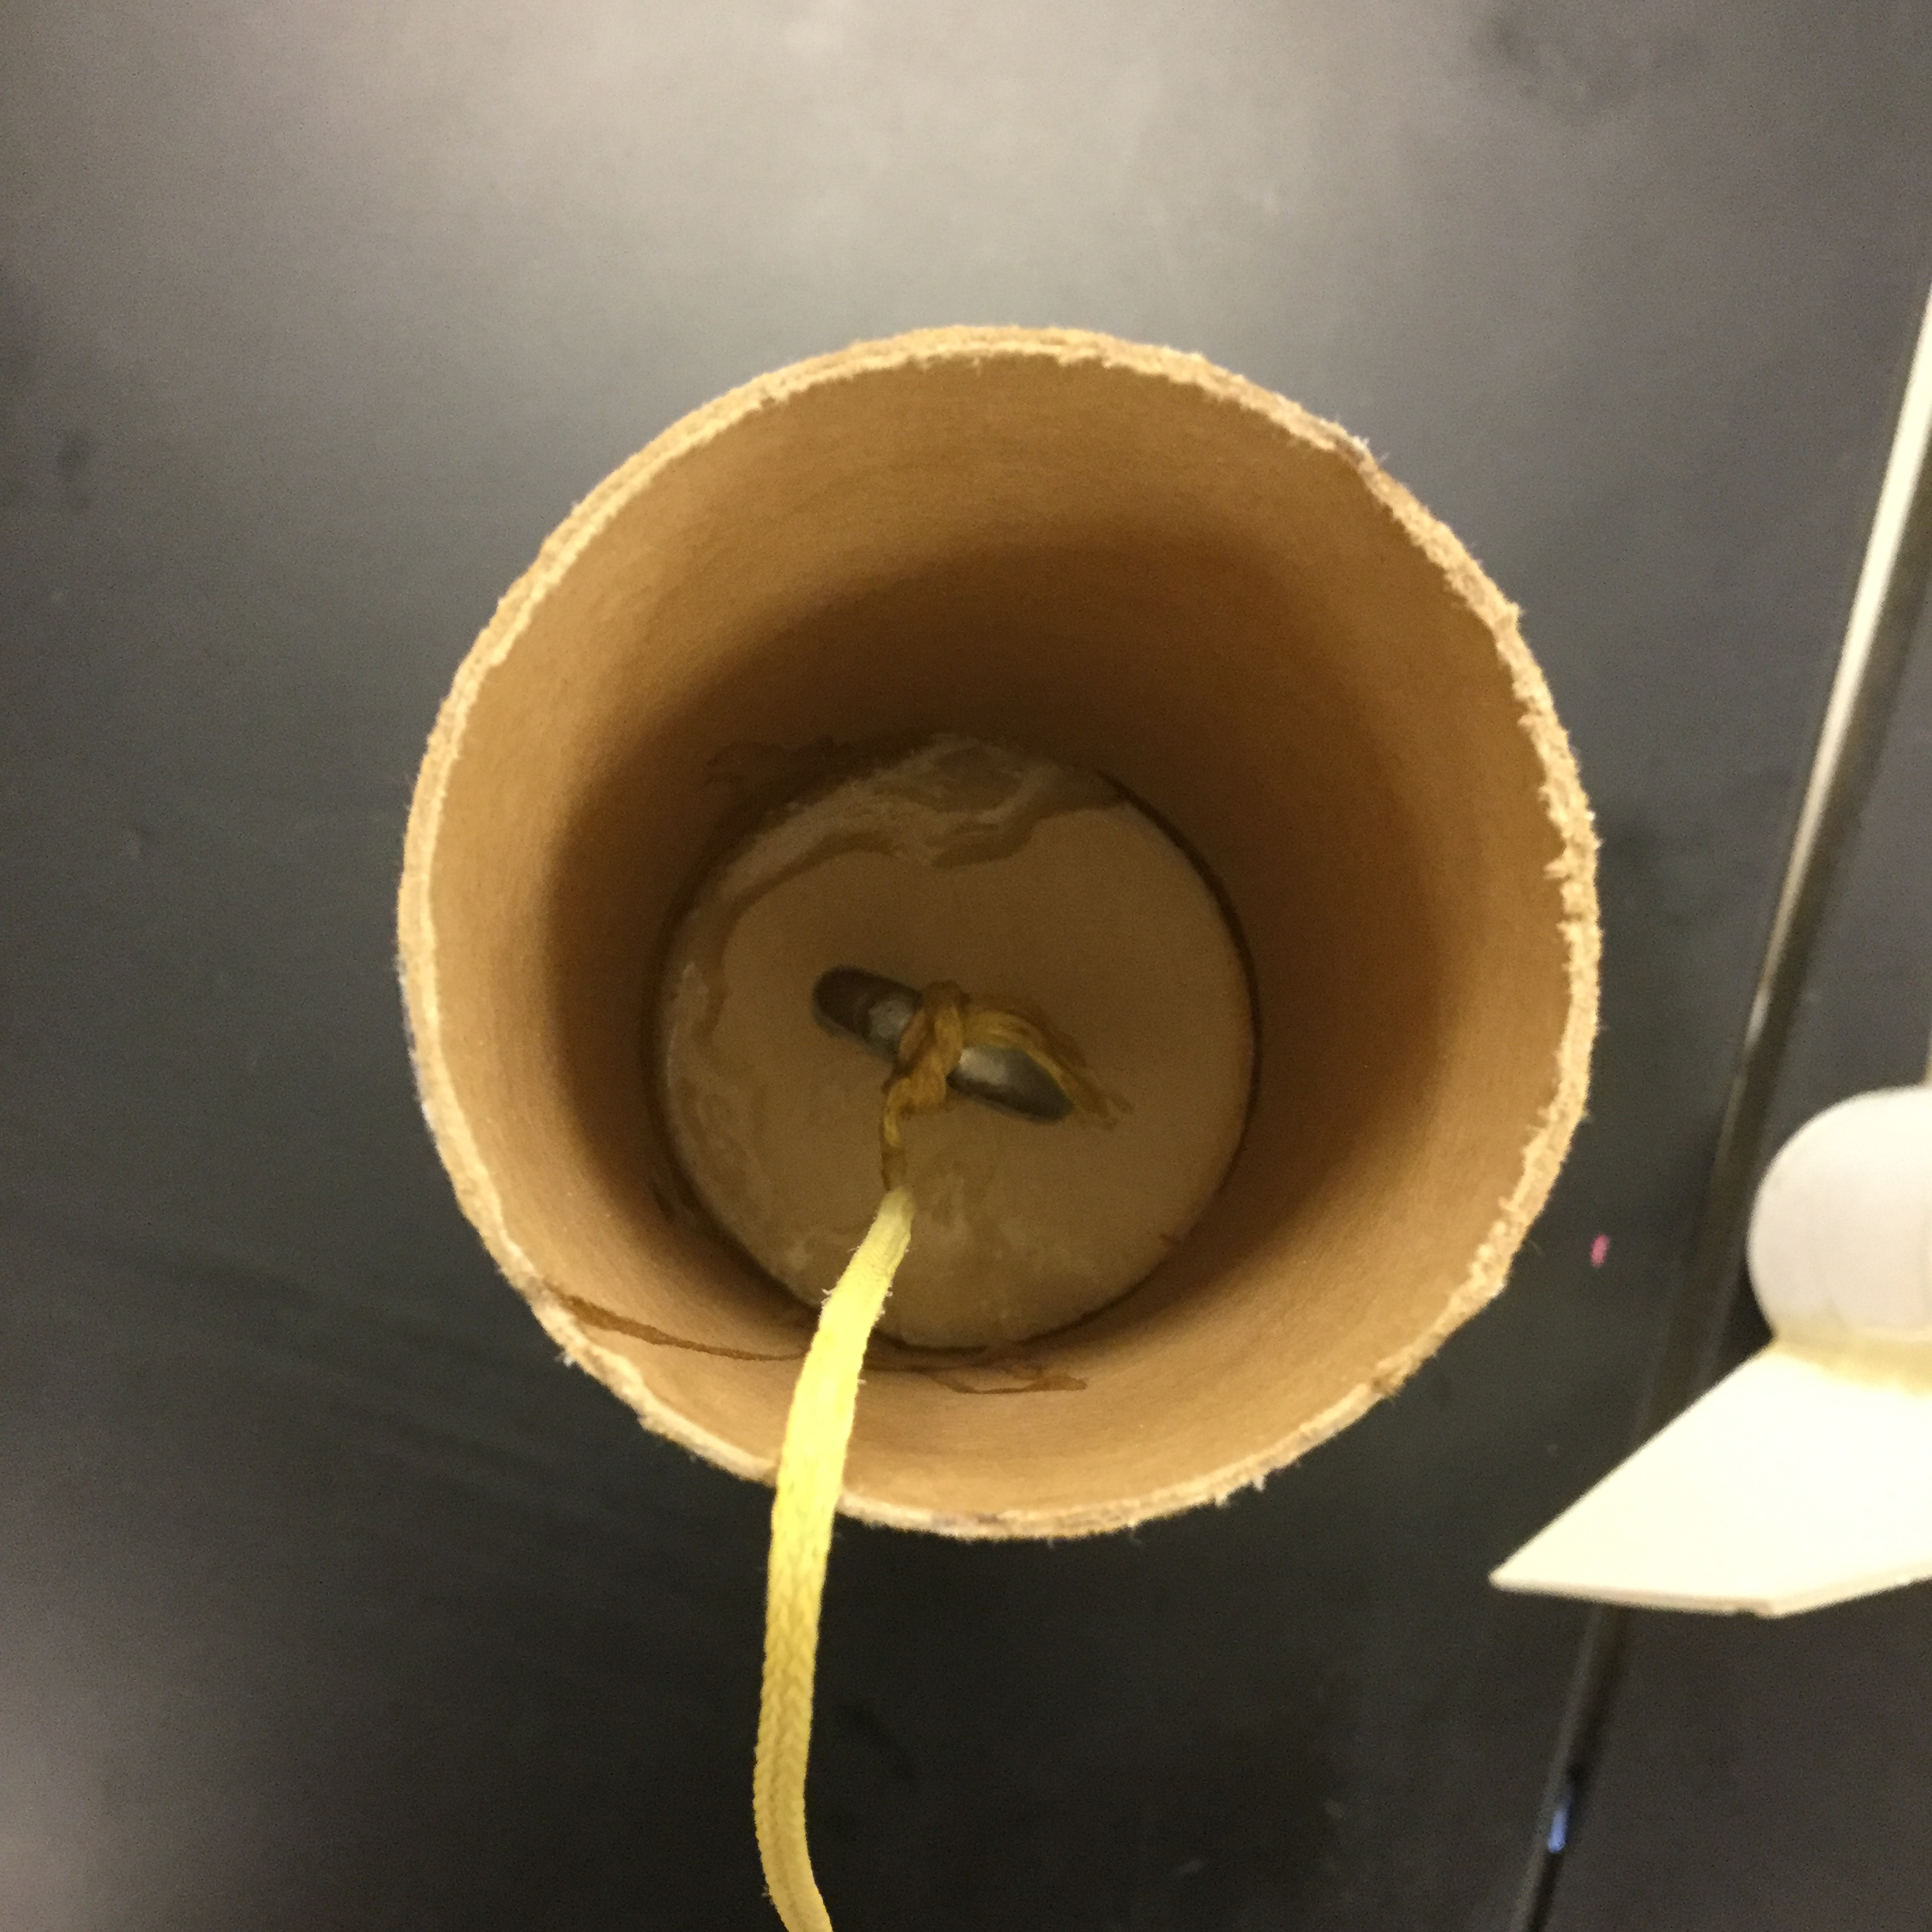
Recovery systems
What we are using strong eye bolts connected to a ¼ inch plywood bulk head and an eye bold connected to the motor mount.
The Kevlar shock cord is very strong and is securely knotted and epoxied to the eye bolts and the parachute is knotted and securely glued to the shock cord..

Slide 8
Recovery methods
We will be using the motor ejection from the motor and drilling into the charge so that both the primary and secondary motor delays will be set at nine seconds.
Our parachute is a 16" CATO Shute which will carry our .97 lb rocket at a descent no faster than 20 fps.
The parachute will be protected by a Nomex heat shield which is 6" by 6" to properly create a barrier for heat in a 2" diameter rocket

Slide 9
Recovery electronics
We will be using a perfect flight P-nut altimeter to document the altitude that we reach.
We will have four pressure ports at approximately 0.025 inches in size.
The only preparation for the altimeter is to charge it and then turn it on and it is ready to go.
The sections of the rocket are secured by a friction fit.
The charges are fired when the delay burns out that is inside the motor.

